Slide 1
K8s in action short introdaction
Created by: Vitalii Klymov 555BM
Supervisor: Dmitriy Uzun

Slide 2
Contents
Kubernetes what is it?
Containerized technology
Most important components 1
Most important components 2
Deployment process
Deployment strategies in k8s
Simple example of cluster creating
Simple example of deploying 1
Simple example of deploying 2
Simple example of deploying 3
Deployed app

Slide 3
Kubernetes what is it?
Kubernetes - is an open source project created by Google corporation used used for containerized app.
Kubernetes have been writing by using golang programing language. Google had kept developing of kubernetes in secret during 10 years before released in 2014
K8s used for containerized app and for:
automation deployment of application;
automation of scaling application;
Automation of managing application;

Slide 4
Containerized technology
With Kubernetes user can use next container runtimes for starting application:
Docker
CRI-O
Containerd
Rocket
The most common use container runtime is “Docker” which used in 99% of cases
Docker uses Linux namespaces and Cgroups for creating containers

Slide 5
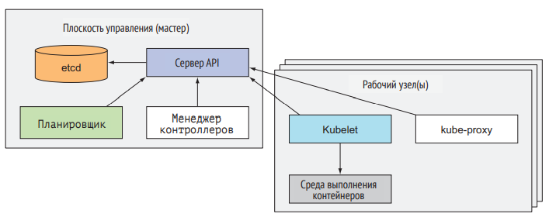
Most important components 1
Main component is k8s is Cluster. Cluster consists of Nodes. Node can be two formats:
Worker node – it is server on which containers are run and worked;
Master node – it is server manage the Worker nodes

Slide 6
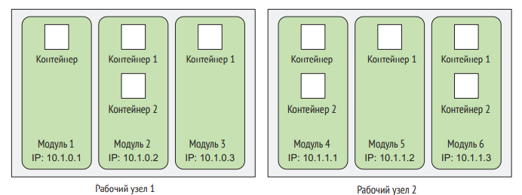
Most important components 2
Pod – group consists of one ore more closely related containers which always runs on one worker node and in one Linux namespace.
A Pod looks like single logical machine with owns IP-address, network name, processes, etc., executes one application.
An application can be a single process or the main app with other additional processes

Slide 7

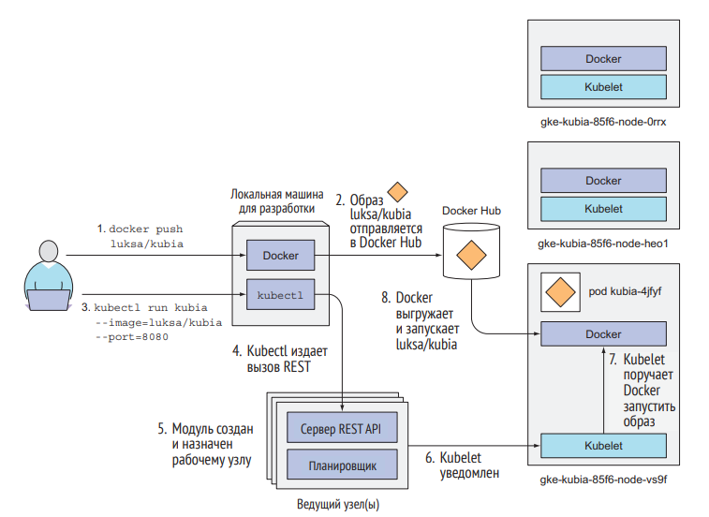
Deployment process

Slide 8
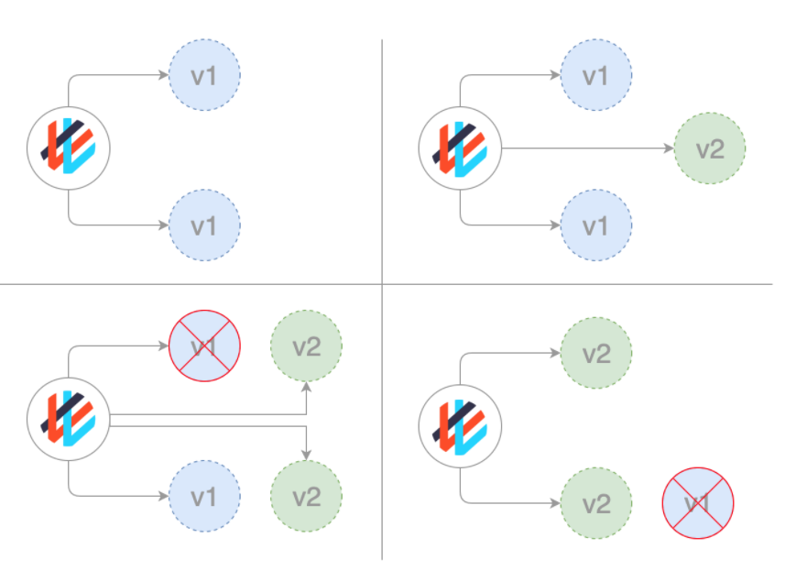
Deployment strategies in k8s
In kubernetes use next deployment strategies of applications:
Rolling
Recreate
Blue/Green
Canary
Dark (A/B)
Rolling strategy

Slide 9
Simple example of cluster creating
I this example is being viewed creating of kuvernetes cluster in Google Cloud Platform which consist of two nodes on e2-medium virtual machine types
After creating of cluster is being shown getting of k8s cluster’s credentials

Slide 10
Simple example of deploying 1
Dockerfile
Nginx.conf
# STAGE1
FROM node:16.13-alpine3.12 AS build
WORKDIR /usr/src/app
COPY package.json package-lock.json ./
RUN npm ci
COPY . .
RUN npm run build -- --prod
# STAGE 2
FROM nginx:1.20.2-alpine
COPY nginx.conf /etc/nginx/nginx.conf
COPY --from=build /usr/src/app/dist/library-spa/ /usr/share/nginx/html
events{}
http {
include /etc/nginx/mime.types;
server {
listen 80;
server_name localhost;
root /usr/share/nginx/html;
index index.html;
location / {
try_files $uri $uri/ /index.html; } }}

Slide 11
Simple example of deploying 2
Deployment.yaml
service.yaml
apiVersion: apps/v1
kind: Deployment
metadata:
name: library-spa-prod-dep
labels:
service: library-spa-prod-dep
owner: asxan
platform: jke
spec:
replicas: 1
selector:
matchLabels:
app: library-spa-prod
template:
metadata:
labels:
app: library-spa-prod
spec:
containers:
- name: library-spa-prod
image: asxan/library-spa-prod:0.2
ports:
- name: library-port
containerPort: 80
protocol: TCP
livenessProbe:
httpGet:
path: /
port: 80
initialDelaySeconds: 25
periodSeconds: 5
resources:
limits:
memory: "256Mi"
cpu: "100m"
apiVersion: v1
kind: Service
metadata:
name: library-app-lb
namespace: default
spec:
selector:
app: library-spa-prod
ports:
- port: 80
targetPort: 80
type: LoadBalancer

Slide 12


Simple example of deploying 3
Applying kubernetes manifests by executing next commands:
After applyin configuration can be got an external IP of load balancer. And deployed app can be access by this IP address.

Slide 13
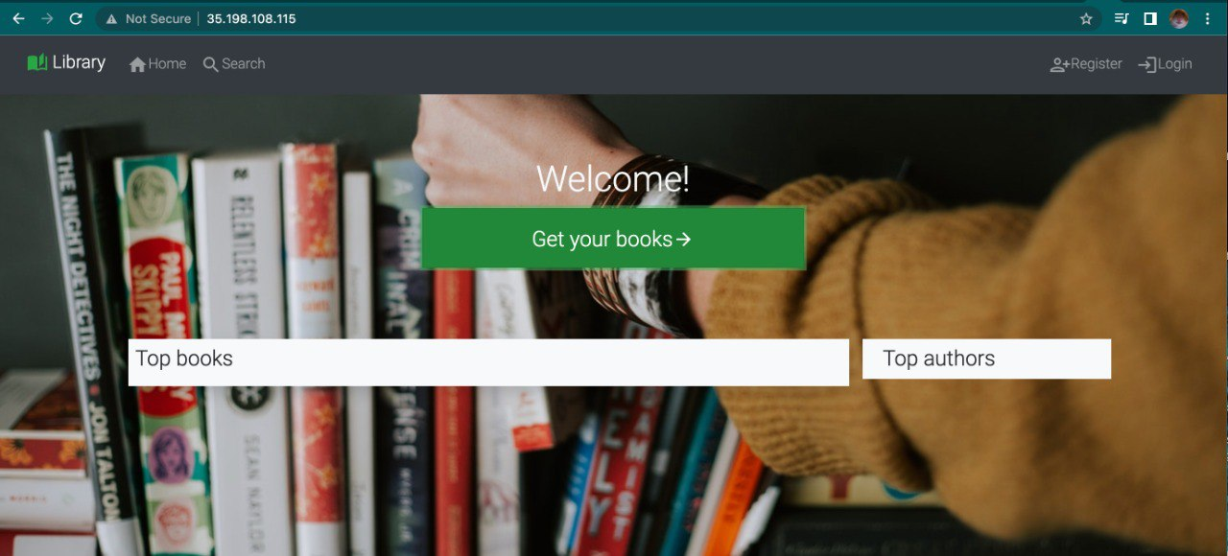
Deployed app

Slide 14
Thank you for your attention!

